Slide 1


Slide 2
What is CloudHour?
Objective of CloudHour
Round-table discussion
Focus on a few key topics
Why It's Important
Rapid changes in cloud security and tech
Stay updated and connected for growth as community
How it will benefit the community
Real-time engagement with hosts and community members
Ask open questions and speak your opinion
Opportunity to affect the next agenda
Notes:
Objective of CloudHour
The objective of CloudHour is to create a collaborative space where professionals can come together to discuss, learn, and share insights on the most pressing topics in cloud security and modern workplace technology.
Why its important
CloudHour is important because, in the rapidly evolving landscape of cloud security and workplace technologies, staying updated and connected is crucial for career growth and organizational resilience
How it will benefit the community
By attending CloudHour, community members will have the unique opportunity to engage with industry experts in real-time, ask questions, network with like-minded professionals, and even have the chance to contribute their own expertise by becoming guest speakers in future episodes.

Slide 3

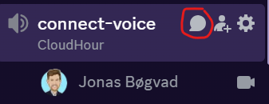
If you prefer to not talk or be asked questions press mute
press mute just mute the mic
If you preferer to chat press

Slide 4
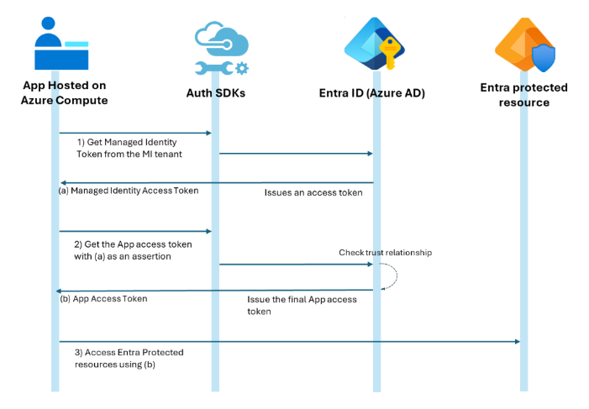
Secrets out, managed identity in
Public Preview of Managed Identities as Federated Identity Credentials for Microsoft Entra.
Notes:
https://devblogs.microsoft.com/identity/access-cloud-resources-across-tenants-without-secrets/

Slide 5
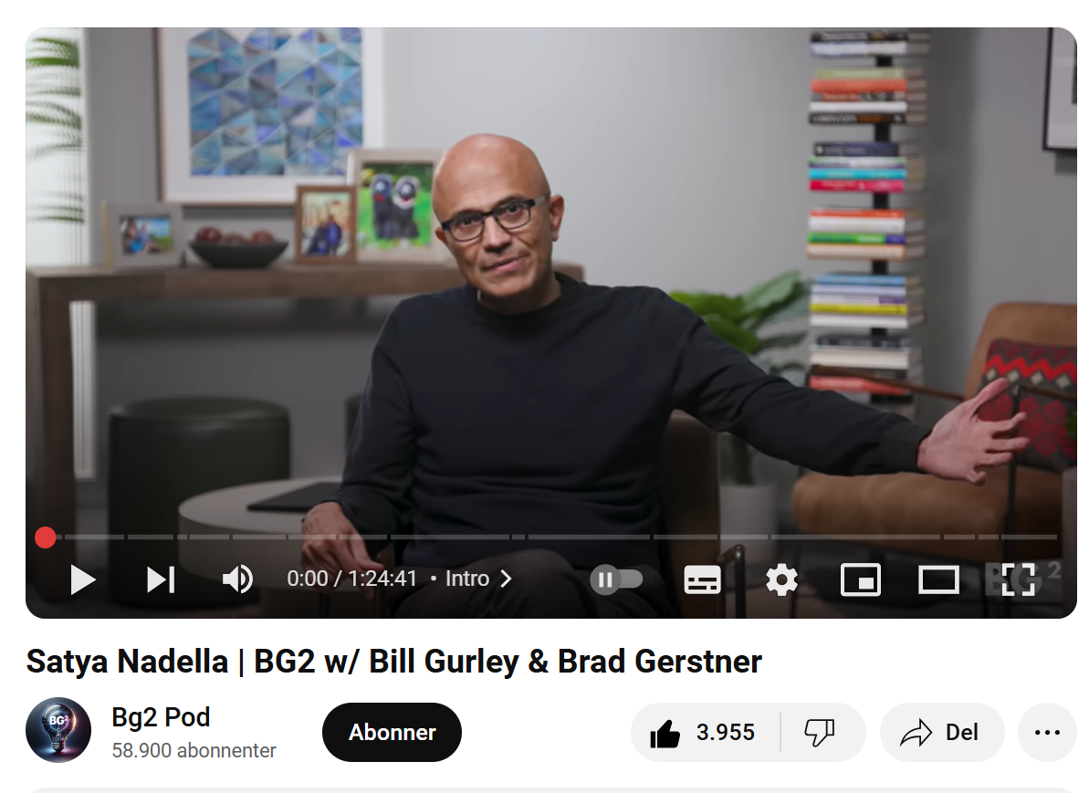
Satya Nadella on podcast
Notes:
https://www.youtube.com/watch?v=9NtsnzRFJ_o

Slide 6
Some links
Windows 365 2025, cool post
Block screen capture for iOS/iPadOS MAM protected apps
DoomPDF
Entra ID Introduces New Graph Permissions for User Accounts
Notes:
https://techcommunity.microsoft.com/discussions/windows365discussions/unlocking-the-power-of-windows-365-in-2025-your-ultimate-learning-guide/4361831
https://techcommunity.microsoft.com/blog/intunecustomersuccess/new-block-screen-capture-for-iosipados-mam-protected-apps/4366312
https://github.com/ading2210/doompdf
https://office365itpros.com/2025/02/04/graph-permissions-for-user-accounts/

Slide 7
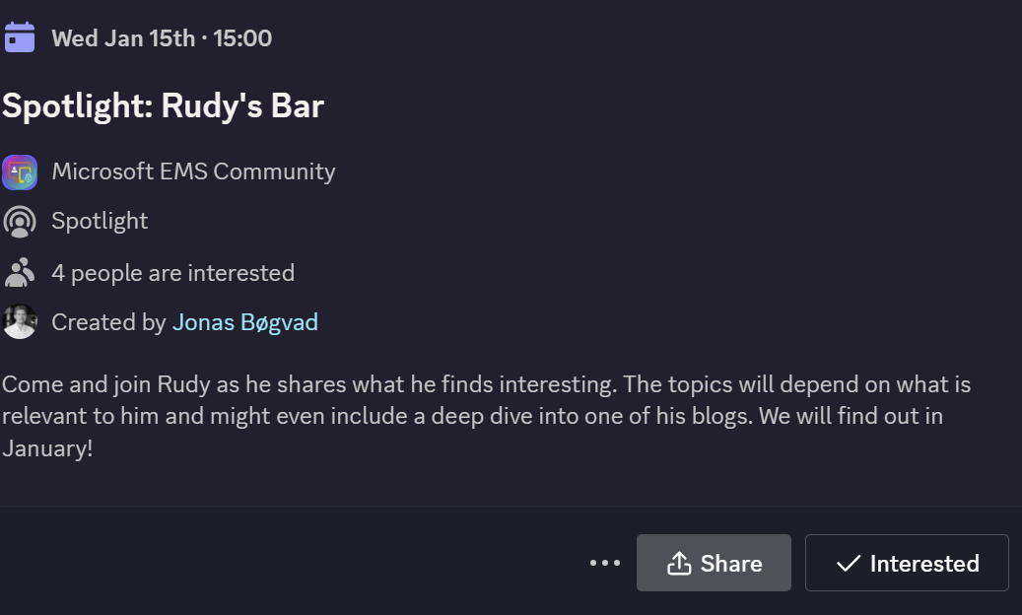
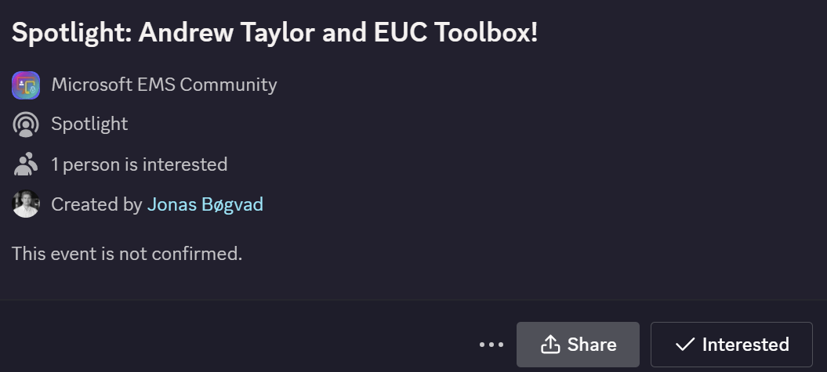
Spotlights sessions
OSD Cloud​
IntuneCD​ (awaiting confirmation on date)
Rudy Webinar ​
Johan Arwidmark ​
Purav (In contact)
Kelvin from CIPP ​
Andrew Taylor and EUC Toolbox (Confirmed)
TUGI tool (Confirmed)
Somesh Pathek (Confirmed)
WinTuner Stephan van Rooji (In contact)
IntuneCD Tobias (In contact)

Slide 8
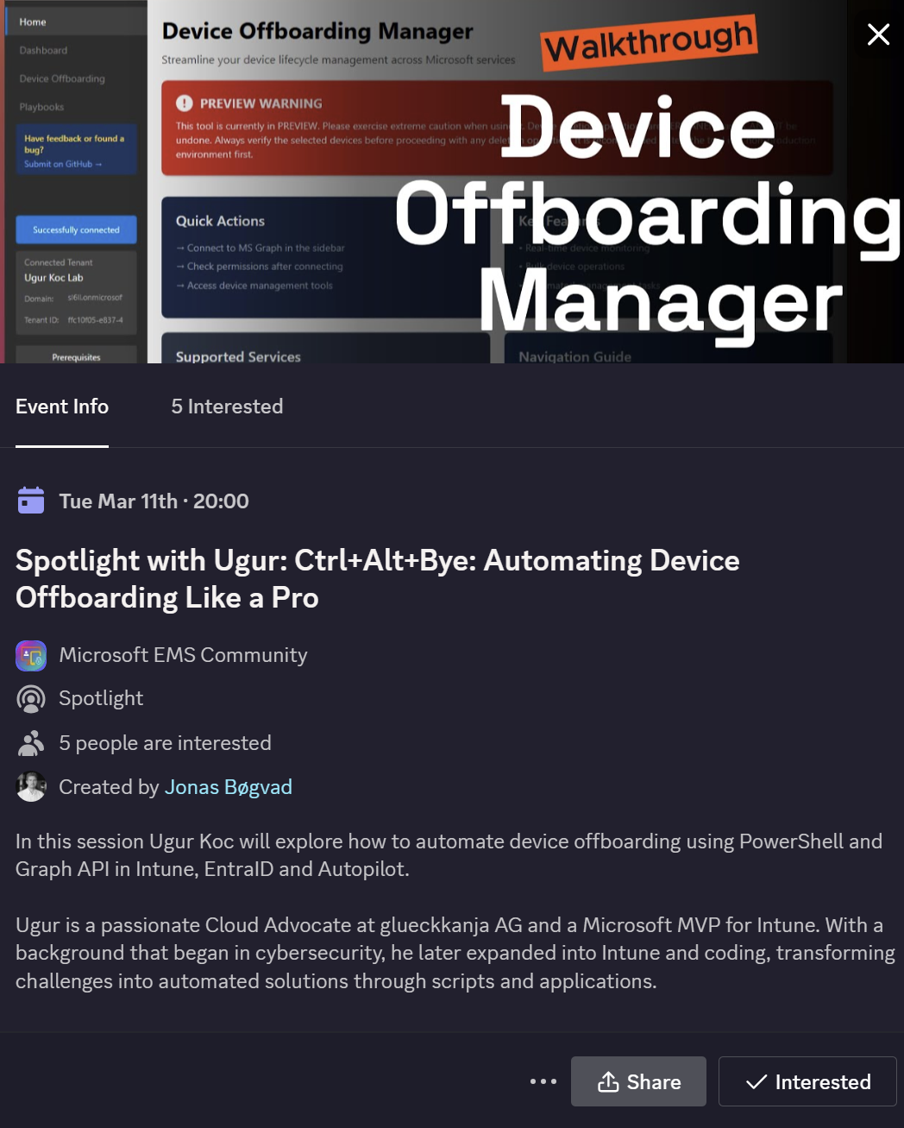
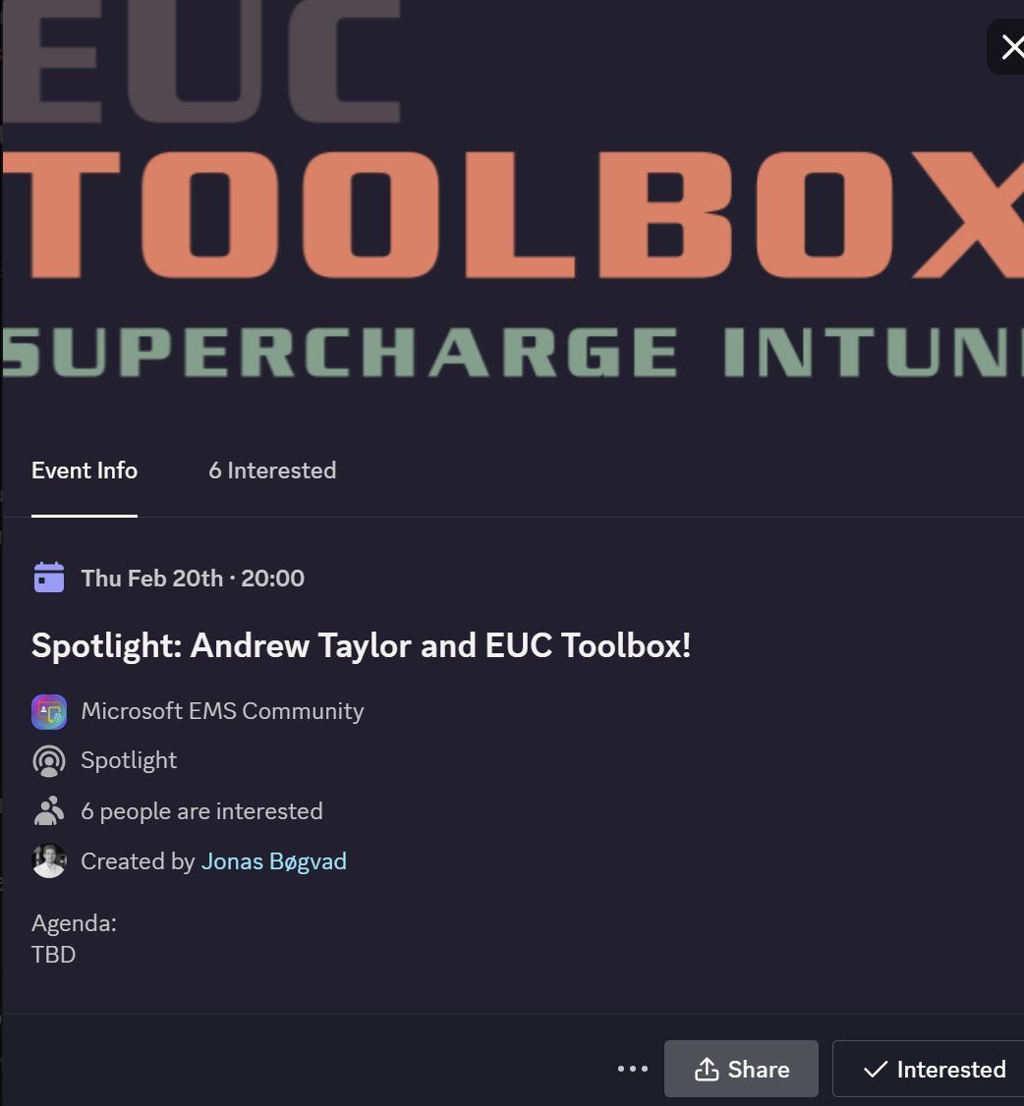
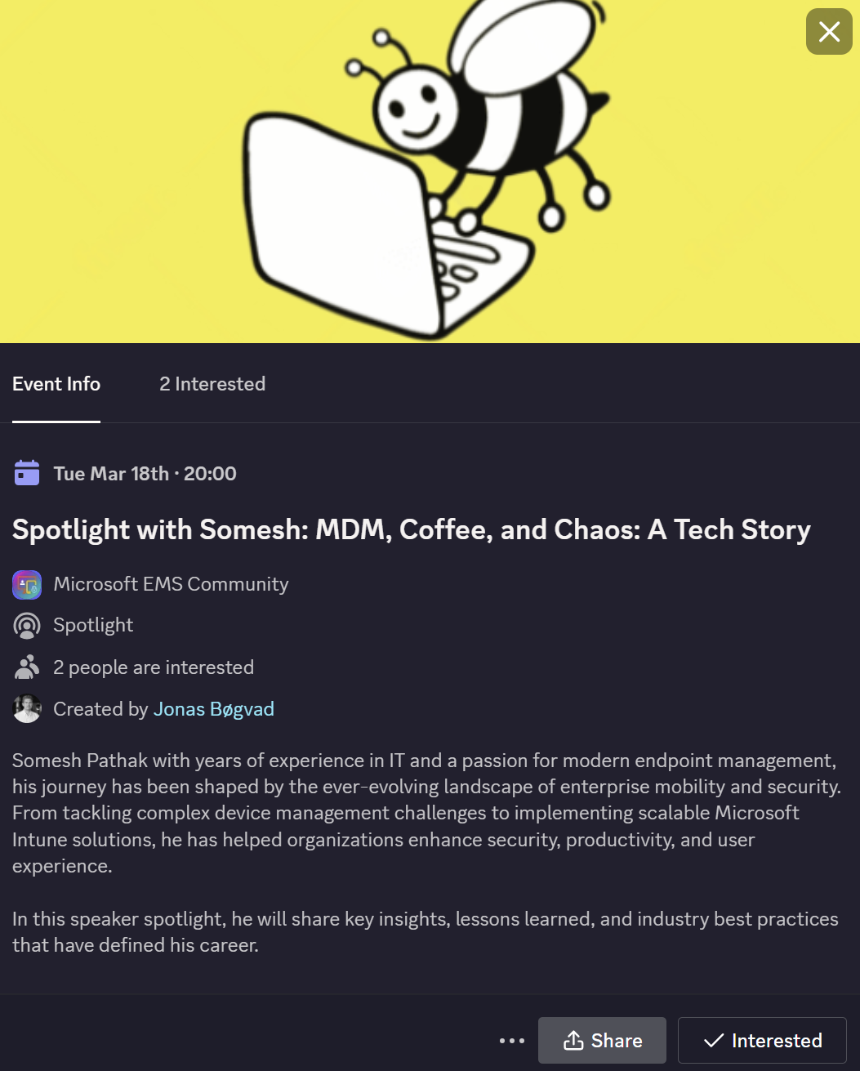
Upcoming spotlight events!
TUGI Talks Tech: Custom Tools for Intune (Feb 10th)
Andrew Taylor and EUC Toolbox! (Feb 20th)
Ugur Koc: Ctrl+Alt+Bye: Automating Device Offboarding Like a Pro (Mar 11th)
Somesh Pathak: MDM, Coffee, and Chaos: A Tech Story (Mar 18th)
More will be announced

Slide 9
Agenda
Administrator protection actions
Apple news and changes (SSO, block screen)
Microsoft Copilot agents (AI corner)
What are you looking forward to in 2025? (exams, skill up, features, new job, can be anything really)

Slide 10
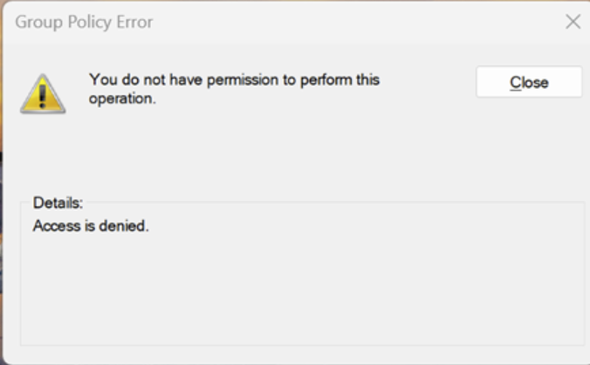
Administrator protection actions
Enforces clear separation between elevated and non-elevated contexts, following the Principle of Least Privilege with explicit elevation actions only. (Stronger Security Boundaries)
Creates password-less, local admin accounts linked to standard users, with isolated profiles to prevent privilege escalation attacks. (System Managed Administrator Accounts (SMAA))
Removes legacy auto-elevation features, mitigating over 90 UAC bypass vulnerabilities tied to COM interfaces, DLL hijacks, and auto-elevating apps. (Eliminating Auto-Elevation Risks)
Reduces unnecessary elevation prompts and “dead-end” admin pathways, enhancing workflows for standard users while maintaining robust security controls. (Improved Usability)
Notes:
https://techcommunity.microsoft.com/blog/microsoft-security-blog/evolving-the-windows-user-model-%E2%80%93-introducing-administrator-protection/4370453

Slide 11
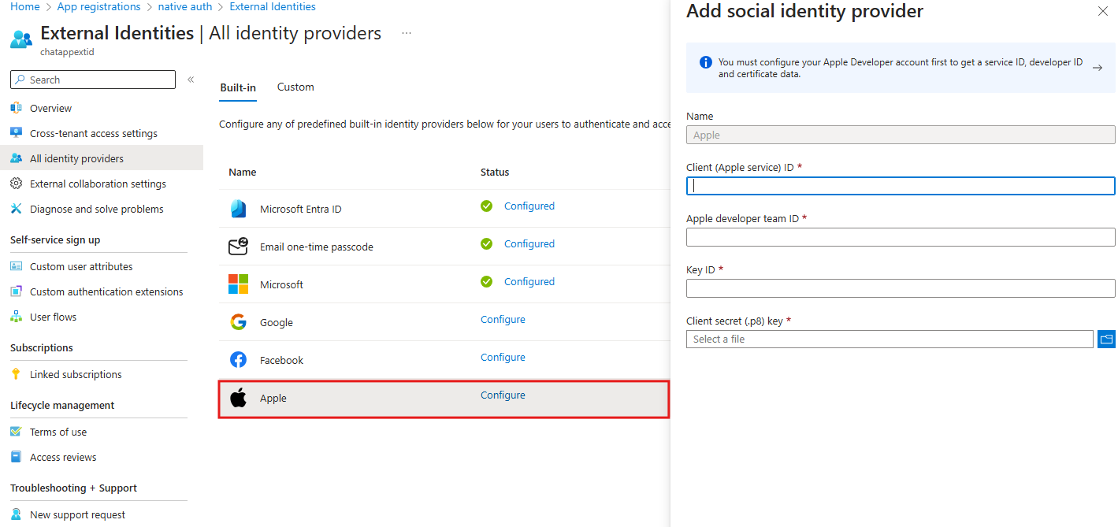
Sign in with Apple is now publicly available for external tenants in Microsoft Entra External ID
Now publicly available alongside Google and Facebook as a pre-configured social identity provider.
Users can sign up/sign in to apps with their Apple ID—SSO supported via OAuth for a smooth, passwordless experience.
Meet App Store guidelines with “Sign in with Apple” for social login-enabled apps.
Notes:
https://devblogs.microsoft.com/identity/openid-connect-social-identity-provider-apple/

Slide 12
The state of Apple Management

Slide 13
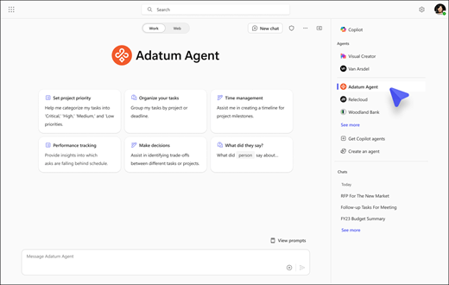
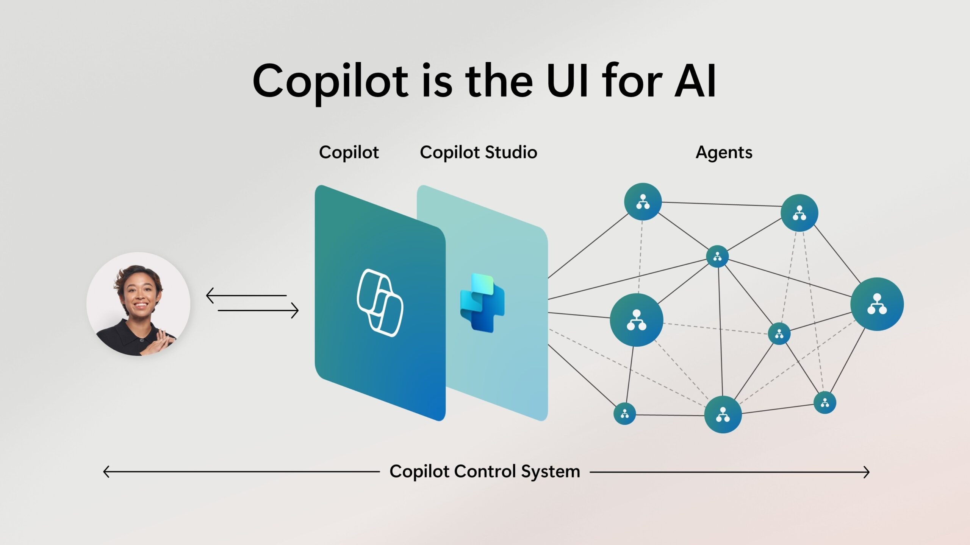
Microsoft Copilot agents (AI corner)
Build, manage, and deploy Copilot agents tailored to your unique business needs
Publish agents directly into Microsoft 365 Copilot, accessible in Teams, SharePoint, and BizChat to enhance productivity.
From simple task automation to autonomous agents that can plan, act, and escalate when needed.
Centralized management with robust security, compliance, and governance built on Microsoft’s Responsible AI principles.
Notes:
https://www.microsoft.com/en-us/microsoft-365/blog/2024/11/19/introducing-copilot-actions-new-agents-and-tools-to-empower-it-teams/

Slide 14
How are we with AI in general?
Jonas Personal notes, when I wrote the title:
Feels like it something we need to love
Starting to see the benefits
Everyone around me is talking about AI

Slide 15
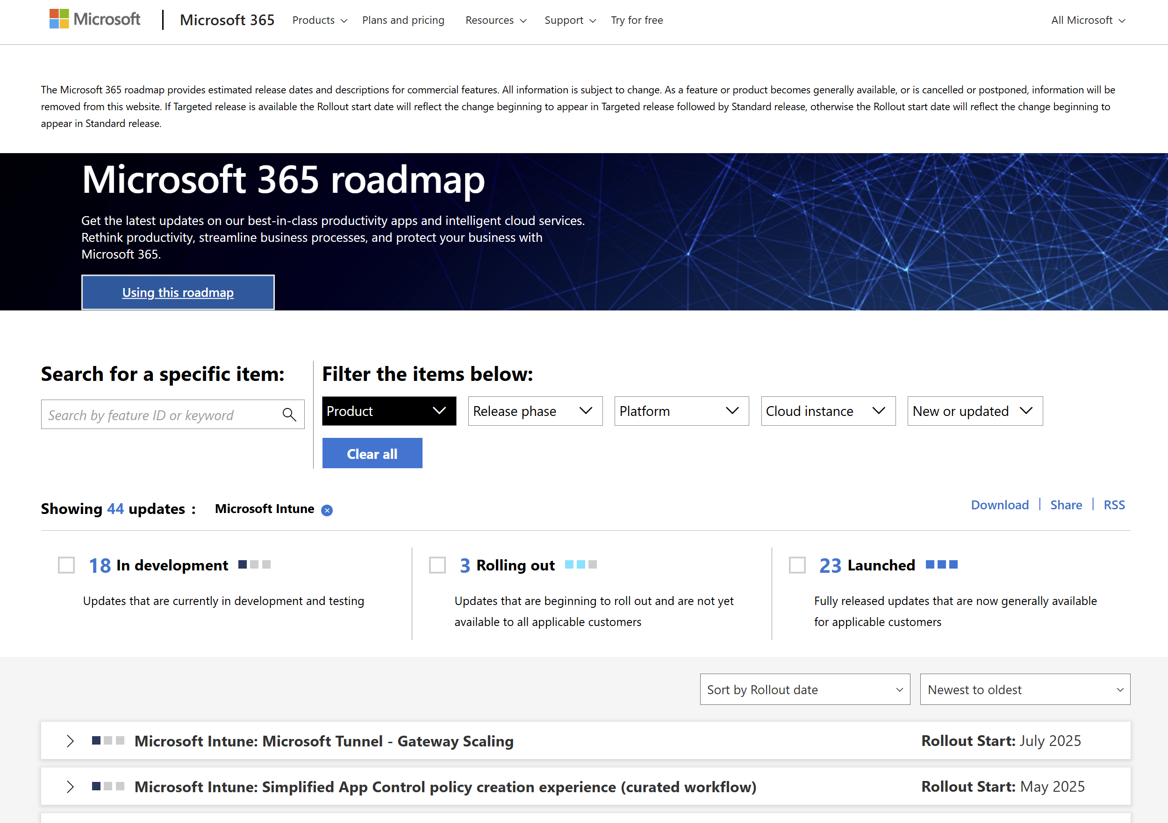
Microsoft Roadmaps
Notes:
https://www.microsoft.com/en-us/microsoft-365/roadmap?filters=Microsoft%20Intune

Slide 16
What are you looking forward to in 2025?
Exams (SC-401)
Skill up
Features
New job
can be anything really

